Slide 1
APUSH REVIEW FOR YOU Periods 1-2
Mr. Winchell
Review 2017-2018

Slide 2
Locations of Major Native American Groups and Culture Areas in the 1600s
Notes:
4
4
4
04/06/98
4
Maize (corn) was a significant food source in present day Mexico and SW US
NW US - Natives hunted, fished, and foraged
Great Basin and Plains - predominantly hunting - lack of natural resources
NE US - mix of agriculture and hunting

Slide 3
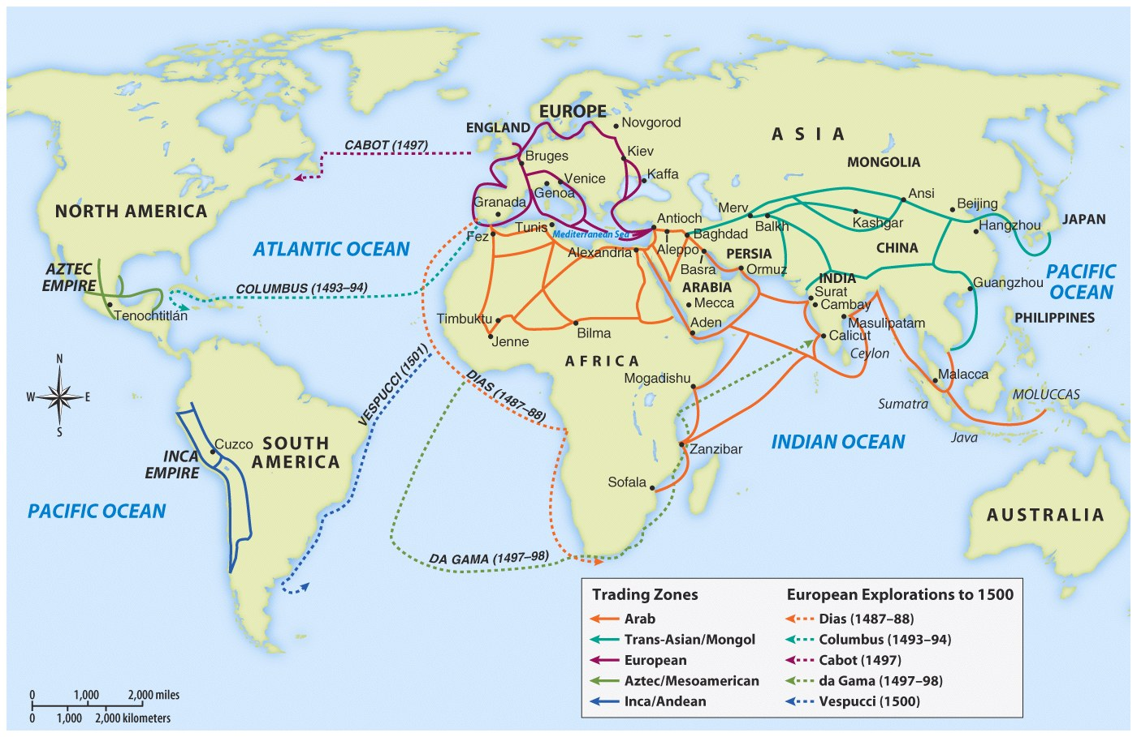
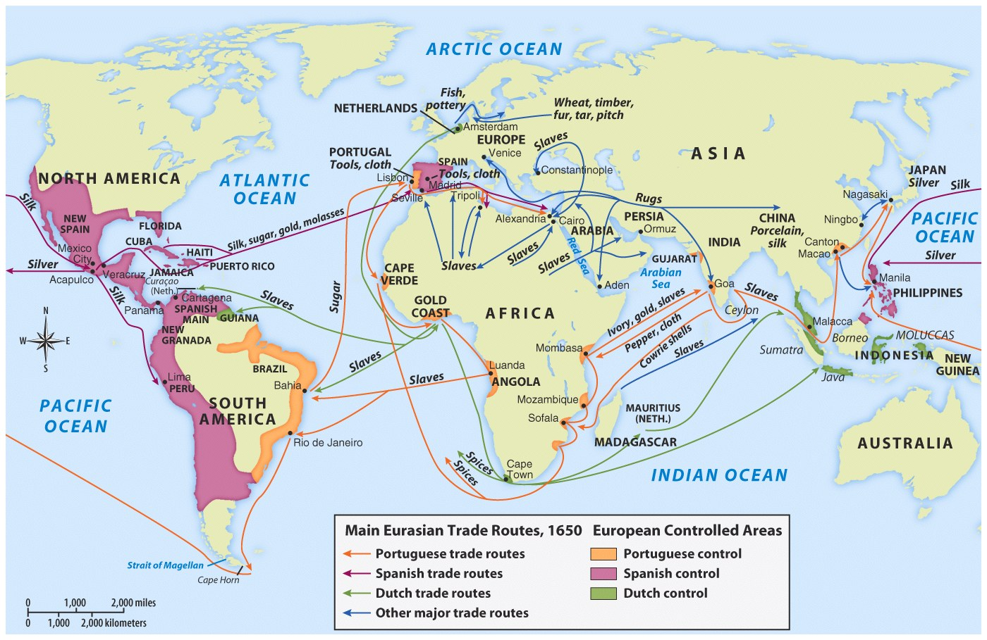
Voyages of European Exploration
Notes:
17
17
17
04/06/98
16

Slide 4
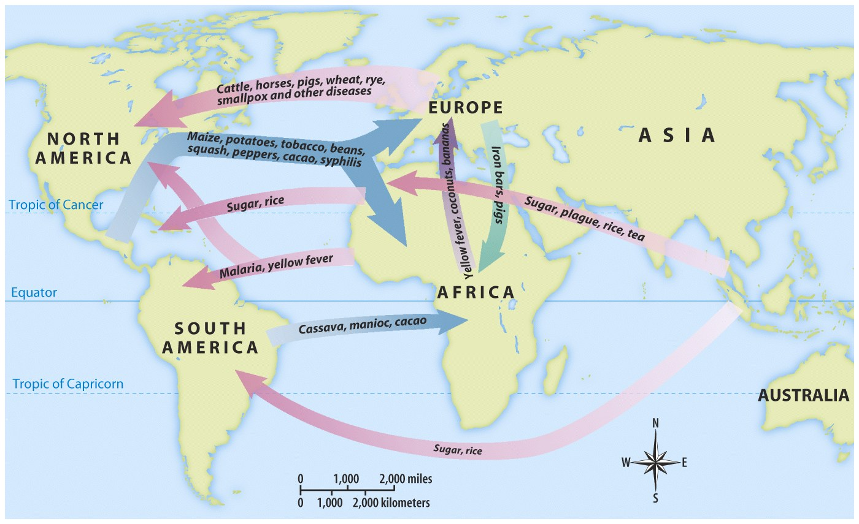
The Columbian Exchange

Slide 5
The Transformation of the Americas
Impacts of Spanish contact:
New caste system and racially diverse populations
Mestizo - mixed Spanish and Native ancestry
Mulatto - mixed Spanish and African ancestry
Encomienda System (16th Century):
Royal grants of land from Spanish crown to Spaniards
Spanish settlers promised to Christianize Natives
Spanish gained tribute
How were Natives impacted?
Many were treated harshly
Heavy manual labor - building roads and infrastructure
Eventually, the system was replaced by African slave labor

Slide 6
The Transformation of the Americas
Debates over treatment of Natives:
Bartolome de Las Casas
How was treatment of Africans and Natives justified?
White superiority, religion, “uncivilized” view of groups
Conflict with Natives:
Europeans sought to change Natives’ way of life and worldview
Natives sought to preserve **autonomy** (independence or self-rule)
Africans adapt to the Western Hemisphere:
Sought to preserve **autonomy**
Combined Christianity with African religions
Maroon communities - made up of runaway slaves

Slide 7
Notes:
Spanish:
Tight control, sought to convert Natives and gain gold
Dutch and French:
Sent fewer settlers, established trade alliances with Natives, often intermarried, traded furs
English:
Colonies heavily relied on agriculture (tobacco - Chesapeake), many men and women populated the colonies, often hostile relationships with Natives

Slide 8
Migrating to the English Colonies
17th century England faced major social changes:
The most significantly was a boom in population; Competition for land, food, jobs led to a large mobile population (vagrants?)
People had choices: could move to cities, Ireland, Netherlands, or America (but this was most expensive & dangerous)

Slide 9
Migrating to the English Colonies
Motives for migration to America:
Religious: purer form of worship
Economic: Escape poverty or the threat of lifelong poverty
Personal: to escape bad marriages, debt or jail terms
Migration to America was facilitated by the English Civil War & Glorious Revolution

Slide 10
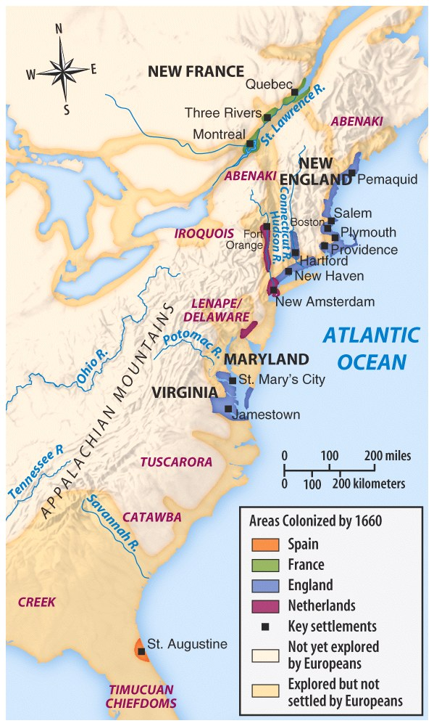

Slide 11
Four Colonial Subcultures
The values of the migrants dictated the “personality” of the newly created colonies; led to distinct (not unified) colonies
The Chesapeake
New England
Middle Colonies
The Carolinas & Georgia

Slide 12
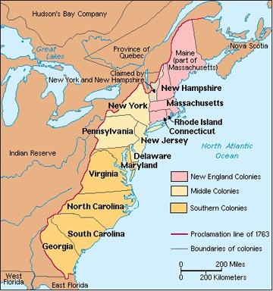

Slide 13
Colonial Regional Identity
New England
Chesapeake and Southern
Political
Social
Families
Male Control
Religion (Puritans)
Education
Economic
Mixed: Agriculture/Trade/Shipbuilding/Lumber/Fishing
Political
Social
Largely Male
WAY higher mortality rate
Clearer Social Classes (Plantation Economy)
Economic
Indentured Servitude/Slavery
Cash Crops: Tobacco/Rice/Sugar/Indigo

Slide 14
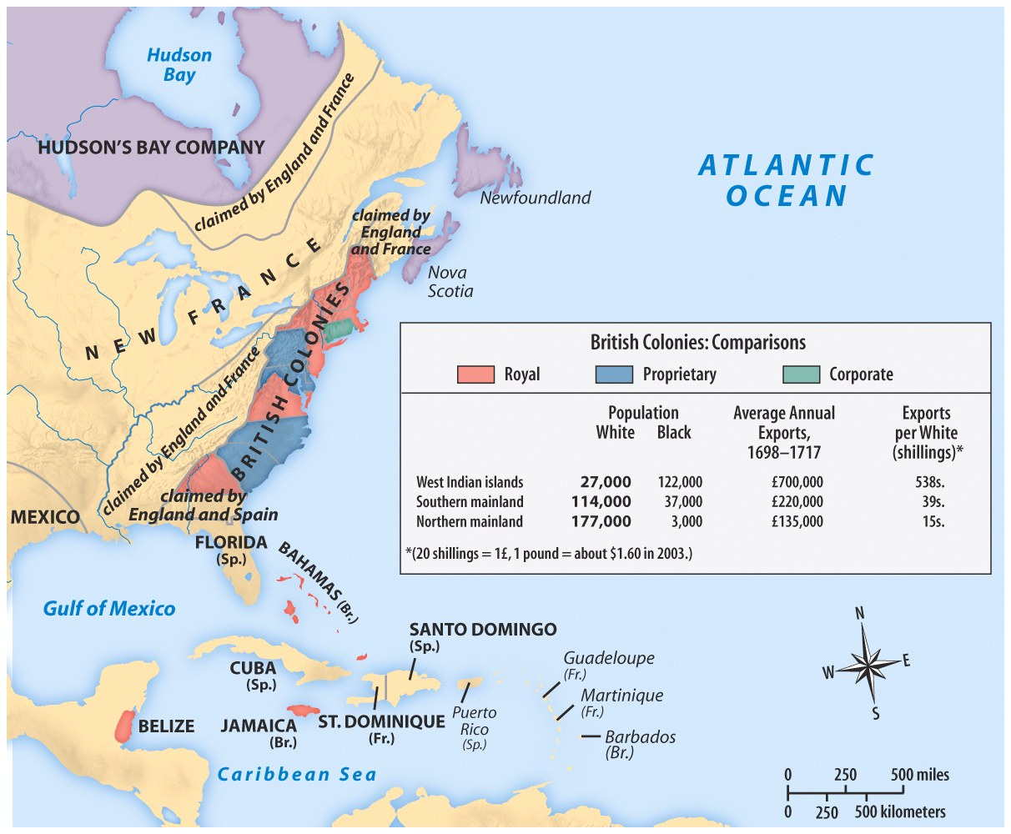
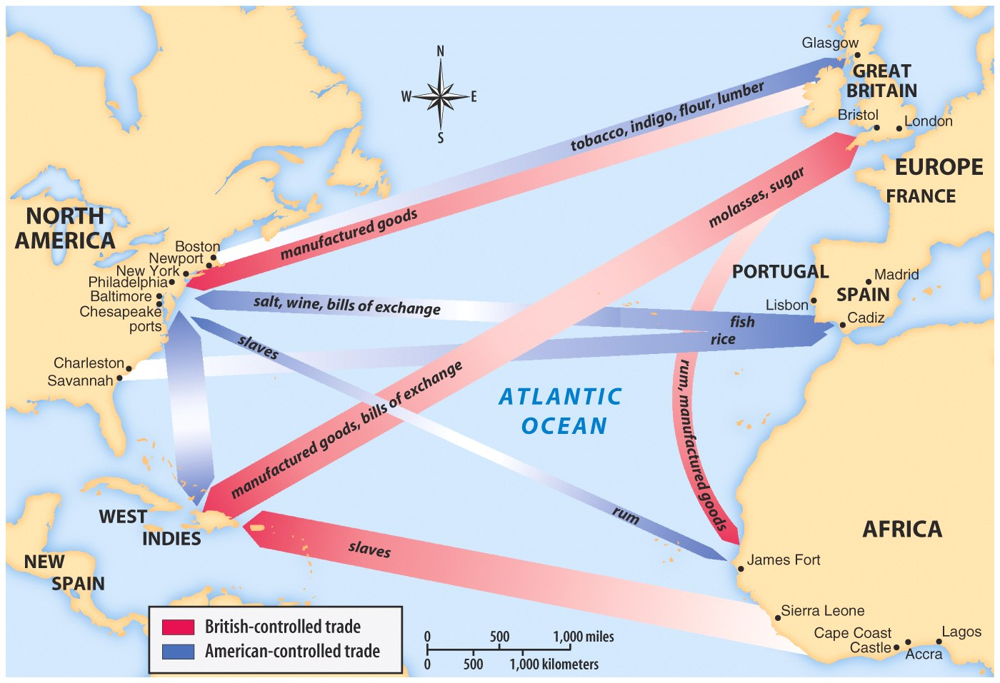

Slide 15
Labor
Indentured Servitude
Slavery
Headright System
Serve for a set amount of years, then set ‘free’
Property
Voting Rights
Approx. ½ die before end of service
75% of Chesapeake migrants in 1600s were indentured servitude
Bacon’s Rebellion
African imported
For life
Approx. 11 million slaves brought to English colonies
Chattel Slavery
1720: Self sustaining
Unique to America in 18th c.
1739: Stono Rebellion
SOUTH CAROLINA

Slide 16
Native Conflicts
1610-1677: Powhatan Wars
1636-1638: Pequot War
1675-1678: King Philip’s War in New England
1680: Pueblo Revolt
1721-1763: Chickasaw Wars
Notes:
Virginia
Massachusets Bay Expansion-near extinction of Pequot tribe
End of resistance in NE
End of Encomienda System-Shows compromise on Spanish
Proxy war between tribes allied with british (Chicasaw) and Chocktaw (French) for control of Mississippi, ends with FI War

Slide 17
A Growing Colonial Identity
Enlightenment
First Great Awakening
Benjamin Franklin
Natural Rights
Role of Government
Emphasized Reason and Science
Questioning of authority
Increase in literacy
A decline in religious devotion
Religion ‘impersonal’
New England 1730s
Virginia 1750s/1760s
Not a ‘unified’ movement
Religious revival
Jonathan Edwards/George Whitfield
Sinners in the Hands of an Angry God
New Universities, first national event, empowered non-elites to challenge religious authority

Slide 18
Big Dates/People/Ideas
1607-Jamestown
1619-House of Burgesses and Slavery
1620-Mayflower Compact and John Winthrop
Roger Williams/Anne Hutchinson
1649-Maryland Act of Toleration
1660/1663: Navigation Acts
1689: Dominion of New England

Slide 19
Conclusions
By 1700:
England’s attitude toward the colonies had changed dramatically
Sectional differences within the colonies were profound
All the colonies were all part of Great Britain but had little to do with each other
Colonists consumed British print, newspapers, books, culture and still desired to be like Britain

